Slide 1
Leveraging System Wide Initiatives in AI to Advance Campus Level Academic and Student Success Priorities
Regional Perspectives on AI Symposium
August 14, 2026
1
Notes:
Kim

Slide 2
Agenda
AI for the Public Good
Student and Faculty AI Literacy
Faculty Advisory Council on Teaching and Technology
System-wide Initiatives and Support for Faculty
AI Tools available to Faculty
SUNY AI Policy

Slide 3
AI for the Public Good

Slide 4
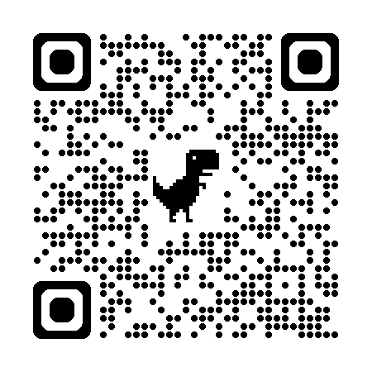
AI for the Public Good
SUNY STRIVE Task Force 2023-2024
“The State University of New York is ready to lead the world in the responsible development of Artificial Intelligence (AI) for the public good.”
What is Responsible AI?
  The foundation of Responsible AI is that artificial intelligence should be developed ethically to benefit the public. As the nation's largest integrated public university system, SUNY is uniquely positioned to bring the ethos of the public good to the AI industry.

Slide 5
Elements of Responsible AI
Ethical Design and Bias Mitigation
Ensure AI systems are designed with fairness in mind by addressing potential biases in data and algorithms to avoid discriminatory outcomes.
Transparency and Explainability
Develop AI models that can explain their decision-making processes, enabling users to understand and trust how outcomes are reached.
Data Privacy Security
Prioritize user privacy by adhering to data protection regulations and implementing robust security measures to safeguard sensitive information.
Accountability and Governance
Establish clear guidelines and accountability frameworks for developers and organizations to responsibly manage AI deployment and usage.
Education
Develop comprehensive AI curricula and learning opportunities to equip students with the knowledge and ethical grounding necessary to design, deploy, and govern responsible AI systems.

Slide 6
Student and Faculty AI Literacy

Slide 7
General Education Requirement
Information Literacy Competency
(Revised, Effective Fall 2026)
Students will
locate information effectively using tools appropriate to their need and discipline;
evaluate information from a variety of sources with an awareness of authority, validity, bias, and origin; and
demonstrate an understanding of the ethical dimensions of information use, creation, and dissemination, whether from traditional sources or emerging technologies, such as artificial intelligence.
Guidance
Students need to acquire information literacy appropriate to the demands of the 21st century, which includes applying all three learning outcomes of this core competency to various sources of information, including emerging technologies, such as artificial intelligence.

Slide 8
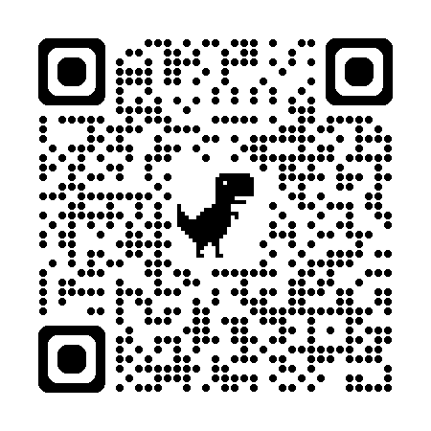
“Before faculty can help students to be AI literate and use AI responsibly, they have to be AI literate.”
What does this mean - what do faculty need to know and what should they be thinking about in order to effectively guide and prepare students for the responsible use of AI for the Public Good?
Faculty are thinking about this in two area:
Integrating AI into course content/curriculum
Student use of AI tools in their coursework (general and discipline-specific)
See resources to support faculty with AI in Teaching and Learning

Slide 9
Faculty Advisory Council on Teaching and Technology (FACT2)

Slide 10
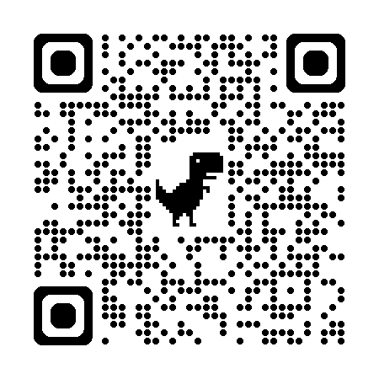
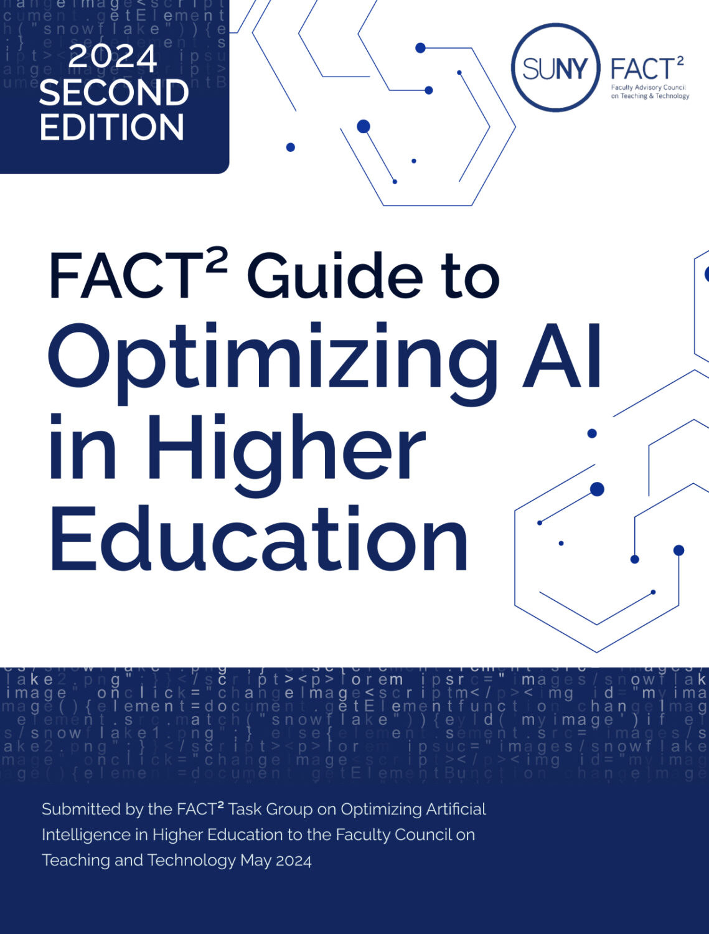
General Faculty Awareness/Guidance
FACT2 Guide to Optimizing AI – v2 (Aug 2024)
Policy Considerations in Teaching and Learning
  Syllabus statements
AI in Course Development and Assessment
AI in Student Research and Creative Works
Evaluating AI Tools in Higher Education
A Brief History of AI

Slide 11
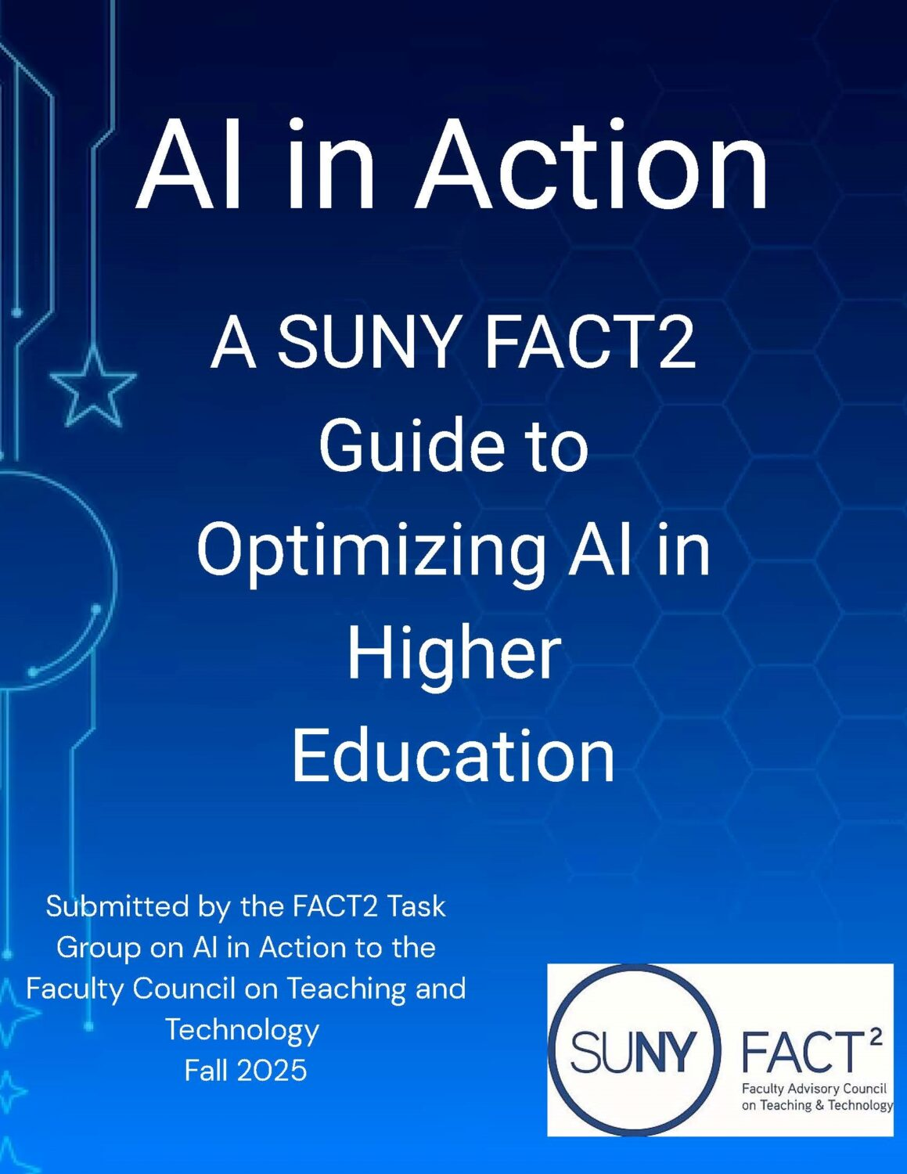
Faculty Use of AI
Considerations and Best Practices
FACT2 AI in Action Guide (Dec 2025)
Considerations for Development of AI Policies and Guidelines
Evaluating AI Tools: Framework and Illustration
Using AI Tutors

Slide 12
Feedback on the Guides
Are you aware of the FACT2 Guides?
How have they been helpful?
What else would you like to see from the FACT2 Council to help faculty?

Slide 13
Intersection of AI and Accessibility
FACT2 AI Guide on AI and Accessibility – coming late Fall 2026
Considerations for where AI can help close accessibility gaps for students
Rubric for evaluation of AI tools for accessibility

Slide 14
Proposed FACT2 Task groups for 2026-2027
Adapting Online Course Quality in Asynchronous Education
Writing Across the Curriculum in the AI Era
Discipline-specific AI Tools for Workforce Readiness
Call for Participation will be shared widely soon

Slide 15
System-wide Initiatives and Support for Faculty

Slide 16
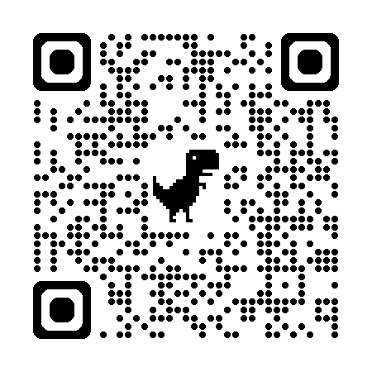
AI for the Public Good Fellows
  Focused on supporting General Education requirement
  Offered webinars for faculty across the system to engage and hear what they are working on
  Hosted AI Meet Ups for more organic discussions/dialogue about AI
  Spoke with campuses and others who invited them to their meetings
  Served as a sounding board with faculty perspectives on everything we are doing related to AI
  Presented at the SUNY General Education Conference (April 9-10)
  Wealth of resources on the AI Fellows website
  Cohort 2 launching in September 2026
Notes:
https://web.cvent.com/event/9abc9fa4-cd57-43b0-aea7-4f1bccd5a741/websitePage:afa49623-1fe4-4a93-8465-4af966aacc00?environment=P2
https://web.cvent.com/event/116e4888-ba75-4bb1-8648-8e4d1bd133f7/websitePage:afa49623-1fe4-4a93-8465-4af966aacc00
https://web.cvent.com/event/3f512a4f-5508-4d80-9dc4-42ec33b4e7b4/websitePage:bd5dd8c6-e988-42d0-8b72-44c573f07f75/
https://system.suny.edu/academic-affairs/fellows-programs/ai-fellows/

Slide 17
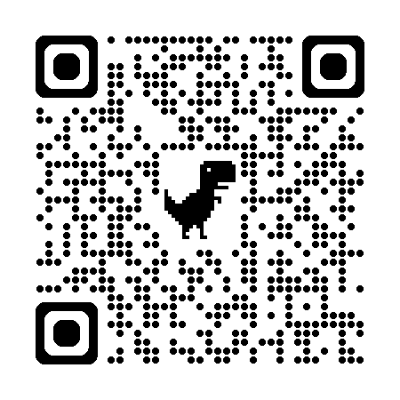
Open Educational Resources
(OER) Gateway Impact Grants
Purpose:
Promote adoption and sustained use of high-quality, accessible Open Educational Resources (OER) in gateway courses in mathematics, English, biology, and chemistry
Fund scalable efforts to expand OER in gateway courses and improve student success and access.
Supported activities include:
Multi-section course adoption or departmental implementation
Faculty engagement and capacity-building
Accessibility improvements
Funding: Up to $20K and up to $40K

Slide 18
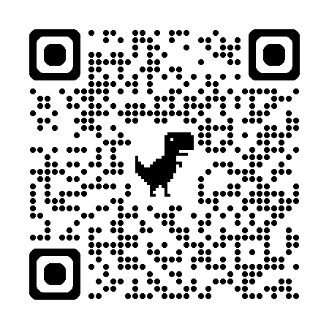
SUNY Academic Innovation Grants
Focus on AI, openness, and accessibility to advance affordable, innovative, and equitable education across SUNY
  Use AI to enhance teaching and learning through affordable, open, and flexible instructional approaches.
  Advance accessibility and equity by reducing barriers for diverse learners.
  Foster collaboration and sustainability across SUNY through innovative instructional models.
Competitive Grants for faculty and staff project teams
Over $1 million in funding annually for:
  Innovative Instruction Technology Grants
  Open Educational Resource (OER) Impact Grants

Slide 19
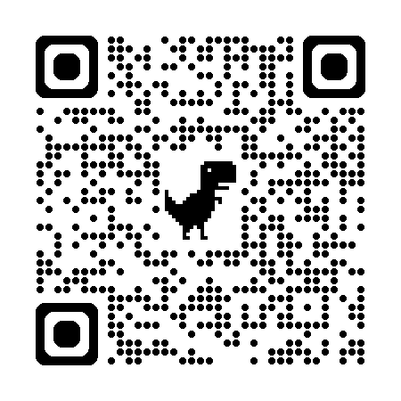
AI Resources and Professional Development
  AI-Related “Tea for Teaching” Podcasts
  AI Policy Generator
  Google AI Certificates
  Microsoft CoPilot Resources
  AI Legal Institute at SUNY (ALIS)
  SUNY Online webinars
  FACT2 Guides, Symposia, and Webinars
  AI for Learning (AI4LN) Fellowship
  SUNY CPD Courses on AI
Notes:
https://cpd.suny.edu/ai-resource-page/

Slide 20
Digital Transformation Project
Portfolio Progress & Delivery Momentum
Strategic Pillar | Mobilizing (4) | Delivering (13) | Realized (3) | Paused (1)
Student Success | Digital Front Door (DFD) | AI Advising AI Tutor Digital Academic Support Solutions (DASS) Community College SIS Non-Credit Student Information Management (NCSIM) eTranscript Digital Backpack Universal Guaranteed Admission
Infrastructure & Cybersecurity Foundation | Digital Identity Verification & Identity Proofing Platform Data Management Platform (DMP) | Vulnerability Management Security Operations Platform and Program Initiative (SOPPI) Unified Communication | Fortinet CrowdStrike
Operational Backbone |  | ProcureNEXT Comprehensive Online Education Initiative (COEI) |  | HRIS
Research and Scholarship | Research Data Repository |  | Research Information Management

Slide 21
AI Tutor and AI in Advising
AI Tutor Project:
How it Works
Faculty-driven, course specific personalized learning support available 24 x 7 x 365 from any computing device students use to study for and complete courses.
The AI Tutor is based on the faculty pedagogy and content they determine the tutor should draw from.
Current Status
Vendor-Provided Platform – procurement in process
Support for Faculty Custom Chatbots – Preparing to pilot in Fall 2026
AI in Advising Project:
How it Works
Personalized, real-time academic and career guidance to students anytime, anywhere.
The solution will provide 24 x 7 x 365, scalable support integrated with campus information systems to improve decision-making, persistence, and on-time completion.
Current Status
Exploratory pilots in place and being launched to inform requirements is underway – Two pilot scenarios.
Beginning to collect feedback from pilots with existing vendors.

Slide 22
Two Pilot Scenarios (1 of 2)
Existing SUNY Campus Vendors
Vendors already working with or in discussions with one or more campuses
Vendor and campus agreement to participate in the pilot experience
Periodic engagement with System Admin to share learnings and insights
Agreement for students and advisors to participate in feedback surveys and/or focus group sessions
Contracting done at the campus level – verification of meeting SUNY AI requirements
New Vendors
Vendors selected to represent a variety of approaches
Vendor and campus agreement to participate in a Year-long pilot experience based on alignment of functionality
Facilitation by System Admin to launch and support the pilot - regular engagement with campus and vendor
Agreement for students and advisors to participate in feedback surveys and/or focus group sessions
Contracting done by System Administration – verification of meeting SUNY AI requirements
Notes:
Kim

Slide 23
Two Pilot Scenarios (2 of 2)
Existing SUNY Campus Vendors
Vendors identified by campuses:
  Ellucian (SmartPlan)
  EAB (Navigate 360)
  Gravyty (Ivy&Ocelot)
  EdSights (Chatbot)
Meeting with vendors and campuses monthly
Outlining survey questions to collect campus feedback
New Vendors
Vendors identified through SOI process
  Google/Nerdery
  D2L Lumi (Learnwise)
Campuses identified to work with each vendor
Working on contracts to include SUNY terms and conditions
Target date for pilots to launch is Fall 2026/Spring 2027

Slide 24
AI Tools Available to Faculty

Slide 25
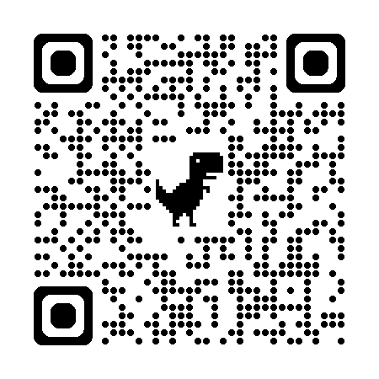
AI in Brightspace (1 of 2)
D2L Responsible AI Principles (Fall 2023)
2026 Fusion Conference: Focus on AI and Trust in multiple dimensions
Brightspace Areas of Focus:
    Efficiencies in faculty workflow
      Available to all faculty on all SUNY campuses (Fall 2025)
    Support student achievement of learning outcomes
      Includes Lumi Tutor + other student functionality
      Available in Brightspace, but not yet deployed in SUNY
    Data and insights
      Coming next from D2L

Slide 26
AI in Brightspace (2 0f 2)
Lumi Pro (faculty)
  Available since Fall 2025 to faculty on all SUNY campuses
  Tools for faculty to support content generation
  Quiz questions, discussion forum prompts, rubrics, alignment of content with learning outcomes, etc.
  Faculty opt-in; faculty review/approval before posting
Lumi Learner Mode (students)
  AI-based study support for students (summaries of content, practice quizzes, etc.)
  Access to Lumi Tutor (if/when available)
  New student functionality within the LMS; avoids having to go outside of Brightspace
  SUNY campuses can opt-in to Beta Test in Fall 2026

Slide 27
Campus-Specific Tools
  Microsoft Co-Pilot
  Google Gemini
  Open AI ChatGPT
  What are your campuses using?
  What else would you like to see?
Notes:
https://cpd.suny.edu/ai-resource-page/

Slide 28
SUNY AI Policy

Slide 29
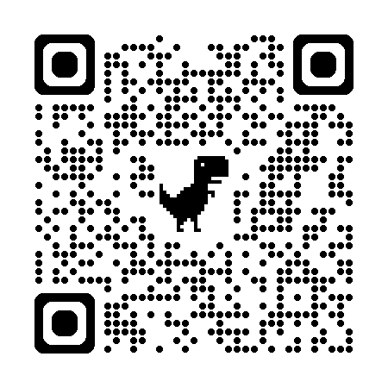
SUNY AI Policy (1 of 3)
Purpose: “The purpose of this policy is to establish guidelines for the acceptable use of Artificial Intelligence (AI) technologies…”
Intention: “…supports SUNY institutions in developing AI policies tailored to their specific circumstances anchored by a common set of systemwide principles.”

Slide 30
SUNY AI Policy (2 of 3)
Policy is high level and intentionally flexible.
Three overarching philosophies:
AI policy is most effective when it is woven into the broader fabric of institutional governance.
Oversight and governance of AI systems should be proportionate to the risk those systems pose.
AI policies relating to the use of pedagogic, student-facing applications in the classroom should be developed through shared governance and should take care not to limit creativity and experimentation in teaching, research, and learning.

Slide 31
SUNY AI Policy (3 of 3)
Campuses must publish their own requirements by Dec 2026
Campuses must confirm the institutions commitment to the Responsible AI Principles and describe the institution’s approach to:
  Roles and Responsibilities
  Procurement
  Domain-Specific governance
  Training
  Protecting Fairness
  Risk-Based Governance
  Review Regularly
Notes:
General AI Systems Institutional Requirements SUNY institutions shall publish AI policies and/or update relevant existing policies no later than December 31, 2026. Upon written request, and for good cause shown, the Chancellor (or designee) may grant a one-time extension of up to two months. These policies must, at minimum, confirm the institution’s commitment to the Responsible AI Principles described above and describe the institution’s approach to:
Roles and Responsibilities: Clarifying faculty, staff, and student roles and responsibilities for the management and oversight of AI systems.
Procurement: Incorporating language in relevant procurements that will, to the extent possible, protect SUNY data, protect against biased, discriminatory and unethical outcomes, and preserve SUNY’s decision-making authority.
Domain-Specific Governance: Reflecting differences in expectations around academic freedom, shared governance, intellectual property, regulatory compliance, and operational risk concerning the use of AI for teaching and learning, research, healthcare, and administrative operations.
Training: Ensuring faculty, staff, and students receive the training necessary to allow them to manage AI tools in a non-discriminatory, ethical and non-biased manner.
Protecting Fairness, Privacy and Security: Scrutinizing AI tools and implementing appropriate and scalable controls to protect institutional data and operations and prevent bias and discrimination.
Risk-Based Governance: Instituting oversight and management mechanisms that reflect the nature and severity of the risks the AI systems present. AI systems that can control or meaningfully influence outcomes affecting the safety, rights, or wellbeing of individuals warrant heightened scrutiny, including more rigorous approval processes, bias reviews, risk assessments, and training requirements.
Review Regularly: Re-evaluating policies with AI-related provisions at regular intervals to account for changes in AI technology, the regulatory environment, and campus operational practices.

Slide 32
Resources to Support Campus Policy Development
Tier 1 — Immediate Priorities (things campuses should have in place as soon as possible)
AI Procurement & Contract Language
High-Risk AI Use Review Process
Faculty Guidance for Classroom AI Use (FACT2 AI Guides and other resources)
Tier 2 — Next Tranche
Additional guidance will address updates to existing campus policies, baseline role-based training for faculty and staff, AI concern and incident response pathways, and domain-specific guidance for research, student services, and administrative operations

Slide 33
Questions/Discussion kim.scalzo@suny.edu
33
Notes:
Kim

